Slide 1
Employee Data Analysis using Excel
STUDENT NAME: P.LAVANYA
REGISTER NUMBER:122201911
DEPARTMENT:III B.COM(CS)
COLLEGE: CHEVALIER T.THOMAS ELIZABETH COLLEGE FOR WOMEN

Slide 2
PROJECT TITLE
Employee Performance Analysis using Excel

Slide 3


AGENDA
Problem Statement
Project Overview
End Users
Our Solution and Proposition
Dataset Description
Modelling Approach
Results and Discussion
Conclusion
3/21/2024 Annual Review

Slide 4

PROBLEM STATEMENT
High employee turnover is hurting our organization’s productivity, morale, and finances, with a 25% increase over the past year. Key reasons include lack of career growth, insufficient compensation, and poor work-life balance. Our goal is to reduce turnover by 15% within the next 12 months.

Slide 5

PROJECT OVERVIEW
.
The project aims to reduce the organization’s employee turnover rate, which has risen by 25% over the past year, impacting productivity, morale, and costs. We will identify root causes, such as career growth, compensation, and work-life balance, and implement strategies to achieve a 15% reduction in turnover within the next 12 months.

Slide 6

WHO ARE THE END USERS?
The end users of this project are the organization’s employees and managers. Employees will benefit from improved career development opportunities, better compensation, and enhanced work-life balance, while managers will experience reduced turnover, improved team stability, and higher productivity. Additionally, the human resources team will utilize the strategies and tools developed to monitor and maintain employee satisfaction and retention.

Slide 7

OUR SOLUTION AND ITS VALUE PROPOSITION
Our solution is a comprehensive employee retention strategy that focuses on improving career development opportunities, offering competitive compensation, and promoting better work-life balance. This approach aims to reduce turnover by enhancing employee satisfaction and engagement, leading to lower recruitment and training costs, improved productivity, and a stronger workplace culture. The value proposition is a more stable, motivated workforce that contributes to long-term organizational success and competitiveness.

Slide 8
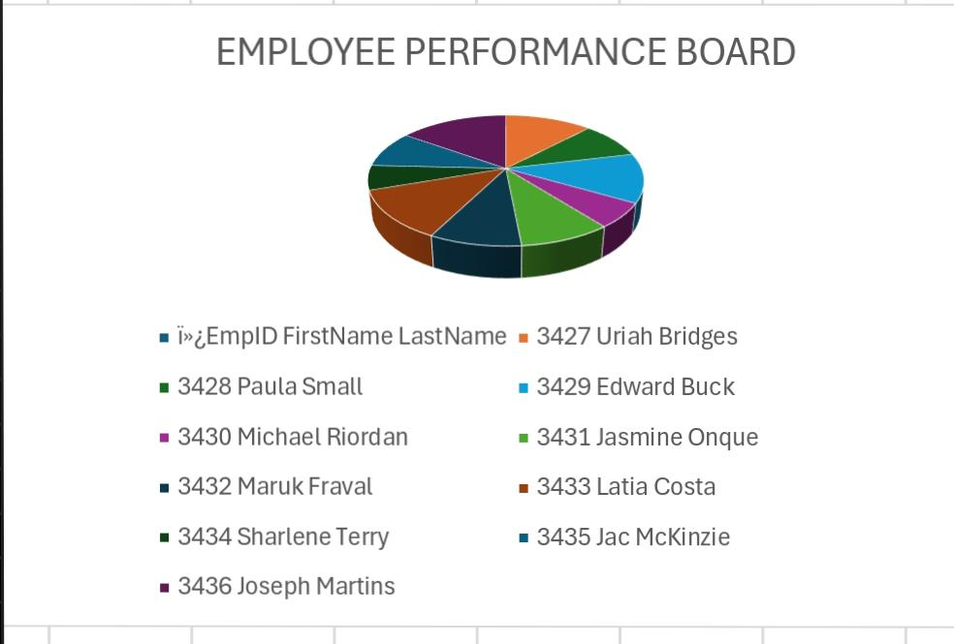
Dataset Description
Our solution goes beyond traditional retention strategies by using data-driven insights to create a personalized employee experience. By leveraging predictive analytics, we can identify at-risk employees and proactively address their concerns with tailored career development plans, personalized incentives, and customized work-life balance initiatives

Slide 9

THE "WOW" IN OUR SOLUTION
We will employ predictive modeling techniques, including logistic regression and machine learning algorithms like decision trees and random forests, to analyze employee data and identify factors influencing turnover. This approach will enable us to forecast which employees are at risk of leaving and understand the underlying causes, allowing for targeted interventions such as personalized development plans and tailored incentives to reduce turnover and improve overall employee satisfaction.
3/21/2024 Annual Review
9

Slide 10
MODELLING
Microsoft Excel spreadsheets allow individuals to organize and display their data visually with models. Excel models are an effective way to forecast future events and occurrences. Learning about Excel modeling can help you make better decisions and predictions for your organization based on past data.
10

Slide 11
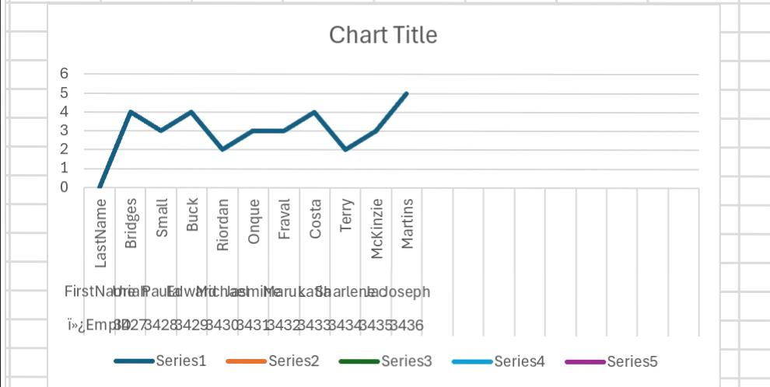
RESULTS
11

Slide 12
conclusion
By leveraging predictive modeling to identify key turnover factors and implementing targeted retention strategies, we aim to reduce employee turnover by 15% within a year. This approach will enhance employee satisfaction, lower recruitment and training costs, and improve overall productivity and morale, leading to a more stable and successful organization.

